Slide 1
The role of pharmacists in Type 2 DM
By Dr Sindeep Bhana
BSc(Wits), MBBCh(Wits), FCP(SA), MMed(Wits), Cert Endo(SA)
Director and Founder of Centre of Advanced Medicine
Honorary Lecturer in the Department of Internal Medicine and Division of Endocrinology at Chris Hani Baragwanath Academic Hospital and School of Health Science/Internal Medicine, University of Witwatersrand
Tel: 010 109 6177
Email: pa@drsbhana.co.za

Slide 2
Disclaimer
I will receive an Honorarium from Roche to give this lecture for Medical Education

Slide 3
Disclosures
SPEAKER’S NAME and credentials | Sindeep Bhana Specialist in Endocrinology & Metabolism BSc, MBBCh, MMed, FCP(SA)
RELATIONSHIPS WITH COMMERCIAL INTERESTS
Grants/Research Support: | Novo Nordisk, Merck, Sanofi
Speakers Bureau/Honoraria: | Abbott, AstraZeneca, Bayer, Boehringer, Whole Again, Servier, Merck, Novo Nordisk, Sanofi, Acino, Viatris and Roche
Consulting Fees: | Merck

Slide 4
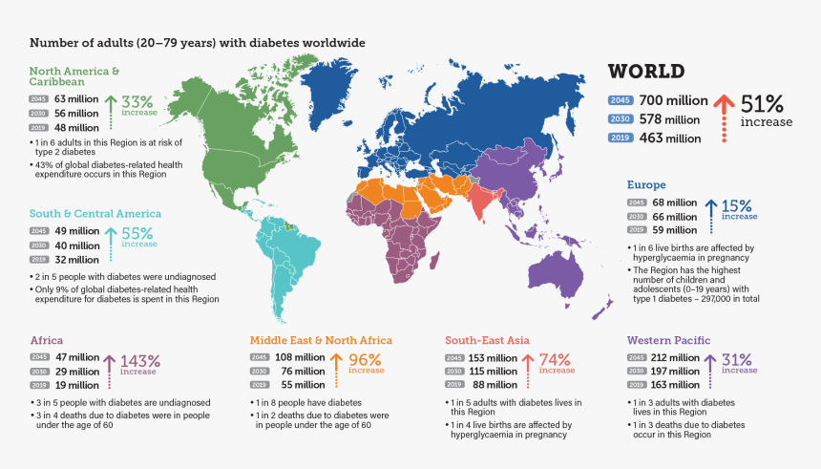
Number of adults with diabetes worldwide
IDF Atlas, 9th Edition, 2019

Slide 5
Diagnosis
Screening with fasting blood glucose

Slide 6
What are the criteria for prediabetes?
 |  | SEMDSA | ADA
HbA_{1c} |  | Not recommended for diagnosis | 5.7 – 6.4%
Fasting Plasma Glucose |  | 6.0 – 6.9 mmol/l | 5.6 – 6.9 mmol/l

Slide 7
Treatment of pre-DM
Lifestyle changes
Metformin
Supplements

Slide 8
What are the criteria for diabetes?
 |  | SEMDSA | ADA
HbA_{1c} |  | Not recommended | >6.5%
Fasting Plasma Glucose |  | >7.0mmol/l | >7.0mmol/l

Slide 9
T2DM treatment strategies revisited
Target-driven therapy*
STEP 4
Basal plus prandial
STEP 3
Basal insulin
STEP 2
OHA combinations
STEP 1
OHA monotherapy
Lifestyle modification
Adapted from Riddle M. Endo Metab Clin NA 1997;26:659―77. Riddle M. Am J Med 2004;116:35―95.
*Individualise
Notes:
Treatment for T2DM needs to be target driven and intensified as the disease progresses.
The stepwise strategy, which begins with lifestyle modification followed by oral agents and then insulin therapy, is frequently applied at a slow pace with long delays between steps.
Insulin treatment strategies should be used earlier to achieve and sustain HbA_{1c} <7%.
Riddle M. Endo Metab Clin NA 1997;26:659―77.
Riddle M. Am J Med 2004;116:35―95.

Slide 10
Causes of Hyperglycemia in Type 2 Diabetes
Peripheral Tissues (Muscle)
Receptor + postreceptor defect
Insulin resistance
Glucose
Liver
Increased glucose production
Pancreas
Impaired insulin secretion
©1997 PPS

Slide 11
11 INTERLOCKING PATHWAYS WHICH CONTRIBUTE TO HYPERGLYCAEMIA
β-cell-Cell-Centric Construct: Egregious Eleven
The β-cell is the FINAL COMMON DENOMINATOR of β-cell Damage
Pancreatic β-cell
Eleven currently known mediating pathways of hyperglycaemia are shown. Many of these contribute to β-cell dysfunction (liver, muscle, adipose tissue [shown in grey to depict additional association with IR], brain, colon/biome, and immune dysregulation/inflammation [shown in blue]), and others result from β-cell dysfunction through downstream effects (reduced insulin, decreased incretin effect, α-cell defect, stomach/small intestine via reduced amylin, and kidney [shown in red])
Colon/biome
Abnormal microbiota; possible decreased GLP-1 secretion
Brain
Increased appetite
Decreased morning dopamine surge
Increased sympathetic tone
8
↓ β-cell function
7
↓ β-cell mass
Insulin
Immune dysregulation /inflammation
FINAL COMMON DENOMINATOR
9
Insulin Resistance
↓ Incretin
effect
↓ α-Cell defect
Liver
Increased glucose production
2
3
6
↓ Amylin
↓ Glucagon
Muscle
Decrease peripheral muscle uptake
5
Stomach/small intestine
Increase rate of glucose absorption
HYPERGLYCEMIA
10
Upregulation of SGLT-2
Adipose
Increased lipolysis
4
Kidney
Increased glucose reabsorption
11

Slide 12
β-CELL CENTRIC MODEL PROPOSES OPTIMISED INDIVIDUAL CARE
Diagnostic tests and monitoring
Lifestyle modification
Pharmacotherapy
HbA1c, fasting blood glucose, and postprandial glucose testing remain the basis of DM diagnosis and monitoring
Early intervention in prediabetes and diabetes
Correct dyslipidaemia – link to β-cell dysfunction
Preferential use of agents with strong evidence of β-cell preservation
Use the least number of agents to target the greatest number of mediating hyperglycaemia pathways
Use regimens that stabilise hyperglycaemia across multiple causes, act synergistically to reduce cardiovascular and other risk factors, and preserve β-cells.
Additional diagnostic testing:
C-peptide; Islet cell antibodies or other inflammatory markers; measures of IR; β-cell mass; markers for environmental damage or mediating pathways for hyperglycaemia; genotyping.

Slide 13
TARGETING THE 11 INTERLOCKING PATHWAYS WHICH CONTRIBUTE TO HYPERGLYCAEMIA
Initiate combination therapy early
Avoid stratifying first-, second- and third-line therapies
Stratification establishes undue competition between classes, which should more rightly be viewed as complementary options rather than salvage therapy after inevitable treatment failure
AVOID sulfonylureas and glinides – their benefits are outweighed by their risks:
hypoglycaemia and weight gain
high rate of treatment failure and subsequent enhanced requirements for antihyperglycaemic management
potential for β-cell exhaustion
Increased risk of cardiovascular events
potential for increased risk of mortality

Slide 14
A multifactorial approach is recommended for control of CV risk in patients with T2D
Risk factor | Goal | Recommendation
Raised blood pressure | <140/90 mmHg* | RAS inhibitors combined with long acting dihydropyridine CCB with thiazide/ thiazide like diuretic
Abnormal blood lipids | LDL cholesterol <100 mg/dl (<2.6 mmol/l) | Lifestyle modification and statin therapy
Tobacco use | Smoking cessation | Counselling and pharmacological therapy
Hyperglycaemia | HbA1c <6.5%† but individualise | Lifestyle modification and individualise treatment
Weight | At least 5% reduction | Avoid therapies that induce weight gain and treat BMI >27 using pharmacotherapy
Notes:
Notes
Both American (American Diabetes Association) and European (European Society of Cardiology/European Association for the Study of Diabetes) guidelines on management of patients with diabetes stress the importance of a multifactorial approach for the control of CV risk
This includes management of hypertension, dyslipidaemia, hyperglycaemia, and risk of thrombosis, as well as cessation of smoking
Abbreviations
ACE, angiotensin converting enzyme; ARB angiotensin receptor blocker; ASA, acetyl salicylic acid; CV, cardiovascular; HbA1c, glycosylated haemoglobin; LDL, low-density lipoprotein

Slide 15
ADA/EASD 2018 consensus for glucose-lowering medication in T2D
To avoid clinical inertia reassess and modify treatment regularly (3–6 months)
FIRST-LINE THERAPY IS METFORMIN AND COMPREHENSIVE LIFESTYLE (INCLUDING WEIGHT MANAGEMENT AND PHYSICAL ACTIVITY) IF HbA_{1c} ABOVE TARGET PROCEED AS BELOW
Established ASCVD or CKD
NO
Without established ASCVD or CKD
ASCVD predominates
HF OR CKD predominates
EITHER/OR
PREFERABLY
Compelling need to minimise hypoglycaemia
Compelling need to minimise weight gain or promote weight loss
Cost is a major issue††‡‡
GLP-1RA with proven CVD benefit*
SGLT-2i with proven CVD benefit*, if eGFR adequate†
SGLT-2i with evidence of reducing HF and/or CKD progression in CVOT if eGFR adequate‡
DPP-4i
GLP-1RA
SGLT-2i†
TZD
GLP-1RA
with good efficacy for weight loss**
EITHER/OR
SGLT-2i†
SU||
TZD‡‡
OR
If HbA_{1c} above target
If HbA_{1c} above target
If HbA_{1c} above target
If HbA_{1c} above target
If SGLT-2i not tolerated or contraindicated or if eGFR less than adequate† add GLP-1RA with proven CV benefit*
SGLT-2i†
SGLT-2i†
GLP-1RA
SGLT-2i†
If HbA_{1c} above target
If HbA_{1c} above target
If HbA_{1c} above target
If HbA_{1c} above target
OR
OR
SGLT-2i†
GLP-1RA
with good efficacy for weight loss**
TZD‡‡
SU||
OR
OR
DPP-4i
DPP-4i
If further intensification is required or patient is now unable to tolerate GLP-1RA and/or SGLT-2i, choose agents demonstrating CV safety:
Consider adding the other class (GLP-1RA and/or SGLT-2i) with proven CVD benefit
DPP-4i if not on GLP-1RA
Basal insulin§
TZD¶
SU||
Avoid TZD in the setting of HF
Choose agents demonstrating CV safety:
Consider adding the other class with proven CVD benefit*
DPP-4i (not saxagliptin) in the setting of HF (if not on GLP-1RA)
Basal insulin§
SU||
TZD
TZD
OR
OR
TZD
GLP-1RA
If HbA_{1c} above target
If HbA_{1c} above target
If HbA_{1c} above target
If triple therapy required or SGLT-2i and/or GLP-1RA not tolerated or contraindicated use regimen with lowest risk of weight gain
PREFERABLY
DPP-4i (if not on GLP-1RA) based on weight neutrality
Insulin therapy basal insulin with lowest acquisition cost
OR
Consider DPP-4i OR SGLT-2i with lowest acquisition cost‡‡
Continue with addition of other agents as outlined above
If HbA_{1c} above target
Consider the addition of SU|| OR basal insulin:
Choose later generation SU with lower risk of hypoglycaemia
Consider basal insulin with lower risk of hypoglycaemia#
If DPP-4i not tolerated or contraindicated or patient already on GLP-1RA cautious addition of: ● SU|| ● TZD¶ ● Basal insulin
*Proven CVD benefit means it has label indication of reducing CVD events. For GLP-1RA strongest evidence for liraglutide>semaglutide>exenatide extended release. For SGLT-2i evidence modestly stronger for empagliflozin>canagliflozin; †Be aware that SGLT-2i vary by region and individual agent with regard to indicated level of eGFR for initiation and continued use; ‡Both empagliflozin and canagliflozin have shown reduction in HF and reduction in CKD progression in CVOTs; §Degludec or U100 glargine have demonstrated CVD safety; ¶Low dose may be better tolerated though less well studied for CVD effects; ||Choose later generation SU with lower risk of hypoglycaemia; #Degludec / glargine U300<glargine U100 / detemir<NPH insulin; **Semaglutide>liraglutide>dulaglutide>exenatide>lixisenatide; ††If no specific comorbidities (i.e. no established CVD, low risk of hypoglycaemia and lower priority to avoid weight gain or no weight-related comorbidities); ‡‡Consider country- and region-specific cost of drugs. In some countries, TZDs relatively more expensive and DPP-4i relatively cheaper

Slide 16
ADA/EASD 2018 consensus recommendations for patients with established ASCVD, HF, or CKD
ASCVD predominates
HF OR CKD predominates
GLP-1RA with proven CVD benefit*
EITHER/OR
SGLT-2i with proven CVD benefit*, if eGFR adequate†
PREFERABLY
SGLT-2i with evidence of reducing HF and/or CKD progression in CVOT if eGFR adequate‡
OR
If SGLT-2i not tolerated or contraindicated or if eGFR less than adequate† add GLP-1RA with proven CV benefit*#
If HbA_{1c} above target
If HbA_{1c} above target
If further intensification is required or patient is now unable to tolerate GLP-1RA and/or SGLT-2i, choose agents demonstrating CV safety:
Consider adding the other class (GLP-1RA and/or SGLT-2i) with proven CVD benefit
DPP-4i if not on GLP-1RA
Basal insulin§
TZD¶
SU||
Avoid TZD in the setting of HF
Choose agents demonstrating CV safety:
Consider adding the other class with proven CVD benefit*
DPP-4i (not saxagliptin) in the setting of HF (if not on GLP-1RA)
Basal insulin§
SU||
*Proven CVD benefit means it has label indication of reducing CVD events. For GLP-1RA strongest evidence for liraglutide>semaglutide>exenatide extended release. For SGLT-2i evidence modestly stronger for empagliflozin>canagliflozin; †Be aware that SGLT-2i vary by region and individual agent with regard to indicated level of eGFR for initiation and continued use; ‡Both empagliflozin and canagliflozin have shown reduction in HF and reduction in CKD progression in CVOTs; §Degludec or U100 glargine have demonstrated CVD safety; ¶Low dose may be better tolerated though less well studied for CVD effects; ||Choose later generation SU with lower risk of hypoglycaemia’; #Caution with GLP-1RA in ESRD

Slide 17
Choosing glucose-lowering medication
In patients with established ASCVD
ASCVD predominates
GLP-1RA with proven CVD benefit*
EITHER/OR
SGLT-2i with proven CVD benefit*, if eGFR adequate†
Hierarchy
Liraglutide
Semaglutide
Exenatide ER
Evidence of benefit strongest for liraglutide; favourable for semaglutide; less certain for exenatide
If HbA_{1c} above target
If further intensification is required or patient is now unable to tolerate GLP-1RA and/or SGLT-2i, choose agents demonstrating CV safety:
Consider adding the other class (GLP-1RA and/or SGLT-2i) with proven CVD benefit
DPP-4i if not on GLP-1RA
Basal insulin§
TZD¶
SU||
Hierarchy
Empagliflozin
Canagliflozin
Evidence modestly stronger for empagliflozin vs canagliflozin
*Proven CVD benefit means it has label indication of reducing CVD events. For GLP-1RA strongest evidence for liraglutide>semaglutide>exenatide extended release. For SGLT-2i evidence modestly stronger for empagliflozin>canagliflozin; †Be aware that SGLT-2i vary by region and individual agent with regard to indicated level of eGFR for initiation and continued use; ‡Both empagliflozin and canagliflozin have shown reduction in HF and reduction in CKD progression in CVOTs; §Degludec or U100 glargine have demonstrated CVD safety; ¶Low dose may be better tolerated though less well studied for CVD effects; ||Choose later generation SU with lower risk of hypoglycaemia

Slide 18
Choosing glucose-lowering medication
In patients with established HF or CKD
HF OR CKD predominates
SGLT-2is preferred over GLP-1RAs as significant, consistent reductions in hospitalisation for HF have been seen in SGLT-2i trials
SGLT-2i
GLP-1RA
PREFERABLY
SGLT-2i with evidence of reducing HF and/or CKD progression in CVOT if eGFR adequate‡
OR
If SGLT-2i not tolerated or contraindicated or if eGFR less than adequate† add GLP-1RA with proven CV benefit*#
Empagliflozin preferred
If HbA_{1c} above target
Avoid TZD in the setting of HF
Choose agents demonstrating CV safety:
Consider adding the other class with proven CVD benefit*
DPP-4i (not saxagliptin) in the setting of HF (if not on GLP-1RA)
Basal insulin§
SU||
Liraglutide preferred
*Proven CVD benefit means it has label indication of reducing CVD events. For GLP-1RA strongest evidence for liraglutide>semaglutide>exenatide extended release. For SGLT-2i evidence modestly stronger for empagliflozin>canagliflozin; †Be aware that SGLT-2i vary by region and individual agent with regard to indicated level of eGFR for initiation and continued use; ‡Both empagliflozin and canagliflozin have shown reduction in HF and reduction in CKD progression in CVOTs; §Degludec or U100 glargine have demonstrated CVD safety; ||Choose later generation SU with lower risk of hypoglycaemia; #Caution with GLP-1RA in ESRD

Slide 19
ADA/EASD 2018 consensus recommendations for patients with a compelling need to minimise hypoglycaemia
Compelling need to minimise hypoglycaemia
DPP-4i
GLP-1RA
SGLT-2i†‡
TZD§
If HbA_{1c} above target
If HbA_{1c} above target
If HbA_{1c} above target
If HbA_{1c} above target
SGLT-2i†
SGLT-2i†
GLP-1RA
SGLT-2i†
OR
OR
OR
OR
DPP-4i
DPP-4i
TZD§
TZD§
OR
OR
TZD§
GLP-1RA
If HbA_{1c} above target
Continue with addition of other agents as outlined above
If HbA_{1c} above target
Consider the addition of SU|| OR basal insulin:
Choose later generation SU with lower risk of hypoglycaemia
Consider basal insulin with lower risk of hypoglycaemia#
†Be aware that SGLT-2i vary by region and individual agent with regard to indicated level of eGFR for initiation and continued use; ‡If eGFR adequate; §Low dose TZDs are better tolerated; ||Choose later generation SU with lower risk of hypoglycaemia; #Degludec / glargine U300<glargine U100 / detemir<NPH insulin
ADA, American Diabetes Association; DPP-4i, dipeptidyl peptidase-4 inhibitor; EASD, European Association for the Study of Diabetes; eGFR, estimated glomerular filtration rate; GLP-1RA, glucagon-like peptide-1 receptor agonist; HbA_{1c}, glycosylated haemoglobin; SGLT-2i, sodium-glucose cotransporter-2 inhibitor; NPH, neutral protamine Hagedorn; SU, sulphonylurea; TZD, thiazolidinedione

Slide 20
ADA/EASD 2018 consensus for glucose-lowering medication in T2D
To avoid clinical inertia reassess and modify treatment regularly (3–6 months)
FIRST-LINE THERAPY IS METFORMIN AND COMPREHENSIVE LIFESTYLE (INCLUDING WEIGHT MANAGEMENT AND PHYSICAL ACTIVITY) IF HbA_{1c} ABOVE TARGET PROCEED AS BELOW
Established ASCVD or CKD
NO
Without established ASCVD or CKD
ASCVD predominates
HF OR CKD predominates
EITHER/OR
PREFERABLY
Compelling need to minimise hypoglycaemia
Compelling need to minimise weight gain or promote weight loss
Cost is a major issue††‡‡
GLP-1RA with proven CVD benefit*
SGLT-2i with proven CVD benefit*, if eGFR adequate†
SGLT-2i with evidence of reducing HF and/or CKD progression in CVOT if eGFR adequate‡
DPP-4i
GLP-1RA
SGLT-2i†
TZD
GLP-1RA
with good efficacy for weight loss**
EITHER/OR
SGLT-2i†
SU||
TZD‡‡
OR
If HbA_{1c} above target
If HbA_{1c} above target
If HbA_{1c} above target
If HbA_{1c} above target
If SGLT-2i not tolerated or contraindicated or if eGFR less than adequate† add GLP-1RA with proven CV benefit*
SGLT-2i†
SGLT-2i†
GLP-1RA
SGLT-2i†
If HbA_{1c} above target
If HbA_{1c} above target
If HbA_{1c} above target
If HbA_{1c} above target
OR
OR
SGLT-2i†
GLP-1RA
with good efficacy for weight loss**
TZD‡‡
SU||
OR
OR
DPP-4i
DPP-4i
If further intensification is required or patient is now unable to tolerate GLP-1RA and/or SGLT-2i, choose agents demonstrating CV safety:
Consider adding the other class (GLP-1RA and/or SGLT-2i) with proven CVD benefit
DPP-4i if not on GLP-1RA
Basal insulin§
TZD¶
SU||
Avoid TZD in the setting of HF
Choose agents demonstrating CV safety:
Consider adding the other class with proven CVD benefit*
DPP-4i (not saxagliptin) in the setting of HF (if not on GLP-1RA)
Basal insulin§
SU||
TZD
TZD
OR
OR
TZD
GLP-1RA
If HbA_{1c} above target
If HbA_{1c} above target
If HbA_{1c} above target
If triple therapy required or SGLT-2i and/or GLP-1RA not tolerated or contraindicated use regimen with lowest risk of weight gain
PREFERABLY
DPP-4i (if not on GLP-1RA) based on weight neutrality
Insulin therapy basal insulin with lowest acquisition cost
OR
Consider DPP-4i OR SGLT-2i with lowest acquisition cost‡‡
Continue with addition of other agents as outlined above
If HbA_{1c} above target
Consider the addition of SU|| OR basal insulin:
Choose later generation SU with lower risk of hypoglycaemia
Consider basal insulin with lower risk of hypoglycaemia#
If DPP-4i not tolerated or contraindicated or patient already on GLP-1RA cautious addition of: ● SU|| ● TZD¶ ● Basal insulin
*Proven CVD benefit means it has label indication of reducing CVD events. For GLP-1RA strongest evidence for liraglutide>semaglutide>exenatide extended release. For SGLT-2i evidence modestly stronger for empagliflozin>canagliflozin; †Be aware that SGLT-2i vary by region and individual agent with regard to indicated level of eGFR for initiation and continued use; ‡Both empagliflozin and canagliflozin have shown reduction in HF and reduction in CKD progression in CVOTs; §Degludec or U100 glargine have demonstrated CVD safety; ¶Low dose may be better tolerated though less well studied for CVD effects; ||Choose later generation SU with lower risk of hypoglycaemia; #Degludec / glargine U300<glargine U100 / detemir<NPH insulin; **Semaglutide>liraglutide>dulaglutide>exenatide>lixisenatide; ††If no specific comorbidities (i.e. no established CVD, low risk of hypoglycaemia and lower priority to avoid weight gain or no weight-related comorbidities); ‡‡Consider country- and region-specific cost of drugs. In some countries, TZDs relatively more expensive and DPP-4i relatively cheaper

Slide 21
The worldwide challenge of glycaemic control HbA_{1c} in T1D and T2D
T1D^{1*}
T2D^{2–4}
Sweden: 8.7%²
Sweden: 8.0%
Poland: 9.0%²
Russia: 7.7%³
Netherlands: 7.5%
Norway: 7.9%
Canada: 7.9%³
Turkey: 8.9–10.6%^{2,3}
Denmark: 7.9%
UK: 8.4%³
UK: 8.3–8.5%
Portugal: 9.7%²
Romania: 9.9%²
Ukraine: 7.4%
South Korea: 8.0%³
France: 8.0%
Greece: 7.6%
USA: 8.0%³
Greece: 9.0%²
USA: 7.5%
Italy: 7.5%
China: 7.6%³
India: 8.6%³
Latin America: 8.5%⁴
New Zealand: 8.3%
Notes:
NB: These data are taken from (mostly) epidemiological and observational studies. The inclusion criteria from some of the studies means that the data cannot be interpreted as the mean HbA_{1C} for all people with T2D in each particular study. However, the slide provides a useful overview of the extent of the problem of glycaemic control for a population of people with diabetes in each country and globally. The following notes provide information about the studies and their inclusion/exclusion criteria that may skew the data.
1. McKnight et al. 2015. This paper reported data gathered in regional or national registries. Data were obtained for children and/or adults with T1D from the following countries (or regions): Western Australia, Austria, Denmark, England, Champagne-Ardenne (France), Germany, Epirus, Thessaly and Thessaloniki (Greece), Galway (Ireland), several Italian regions, Latvia, Rotterdam (the Netherlands), Otago (New Zealand), Norway, Northern Ireland, Scotland, Sweden, Volyn (Ukraine), USA and Wales) from population or clinic-based registries. The sample size with available data varied from 355 to 173 880. Proportions with HbA1c <58 mmol/mol (<7.5%) and ≥75 mmol/mol (≥9.0%) were compared by age and sex.
2. Oguz et al 2013
Study name ‘TREAT’. This was a prospective 24-month, observational study in patients with T2D initiating insulin in clinical practice. Patient characteristics were collected at baseline and metabolic outcomes at 3, 6, 12, 18 and 24 months after initiation. 985 patients were enrolled, 886 at baseline and 734 at 24 months.
3. Polinski et al. 2015 MOSAIc is a longitudinal, observational study following patients' diabetes care in 18 countries: United Arab Emirates (UAE), Argentina, Brazil, Canada, China, Germany, India, Israel, Italy, Japan, Mexico, Russia, Saudi Arabia, South Korea, Spain, Turkey, United Kingdom, United States. Eligible patients are age ≥18 years, have T2D, and have used insulin for ≥3 months with/without other antidiabetic medications.
4. Mendivil et al. 2014. The objective of the EDGE-Latin America study was to assess the proportion of patients on vildagliptin add-on dual therapy who respond to treatment over a 12-month follow-up, relative to comparator oral anti-diabetes dual therapy, in a usual care setting. Participants were patients with type 2 diabetes (T2D) aged 18 years and older from 311 centres in Argentina, Colombia, Ecuador, Mexico and Venezuela. Patients were taking monotherapy with an oral antidiabetes drug (OAD), and were prescribed a new add-on OAD based on the judgment of their personal physician. According to this choice, patients were assigned to one of the two cohorts: vildagliptin or comparator OADs.

Slide 22
Common barriers to achieving glycaemic control
Hypoglycaemia¹
Weight gain²
Complexity¹
Cost⁴
Adherence⁴
More than half of patients with type 2 diabetes on basal insulin are not at target HbA_{1c}⁵
T2D, type 2 diabetes
1. Peyrot et al. Diabet Med 2012;29:682–689; 2. Carver C. Diabetes Educ 2006;32:910–917; 3. Giugliano et al. Diab Care. 2011;34:510–517; 4. Fidler et al. J Med Econ. 2011;14(5):646-55; 5. Curtis & Lage. J Med Econ 2014;17:21–31
Notes:
Patients and health care professionals face many potential barriers to achieving glycaemic control with ongoing basal insulin therapy. These include fear of hypoglycaemia, potential weight gain and complex and inflexible regimens, all of which adds to a patient’s burden and affects patient adherence to treatment.

Slide 23
Weighing the concerns of the patient when choosing the right medication
Medication | Risk of hypoglycemia | Weight
GLP-1 RA | ↔️ | ⬇️⬇️
SGLT-2 inh. | ↔️ | ⬇️
DPP-4 inh. | ↔️ | ↔️
Metformin | ↔️ | ↔️
Pioglitazone | ↔️ | ⬆️⬆️
Insulin and GLP-1 RA | ⬆️ | ↔️⬇️
Sulfonylurea | ⬆️ | ⬆️
Insulin (DEVOTE, SWITCH 2) | ⬆️⬆️ | ⬆️
Insulin and Sulfonylurea | ⬆️⬆️⬆️⛔️ | ⬆️⬆️⬆️
⛔️

Slide 24
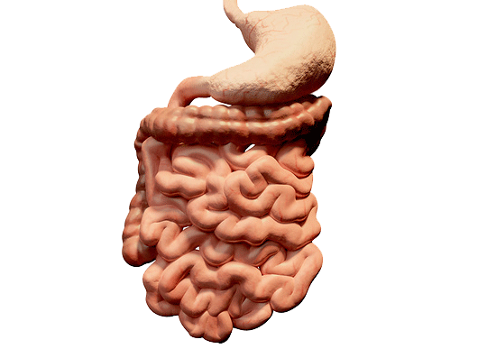
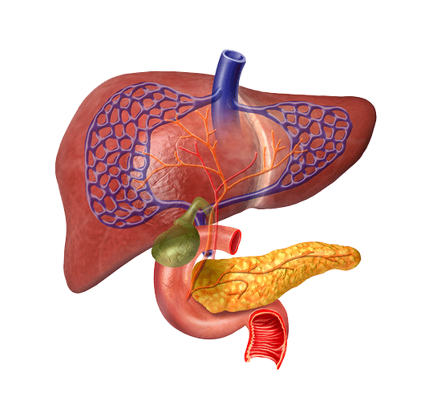
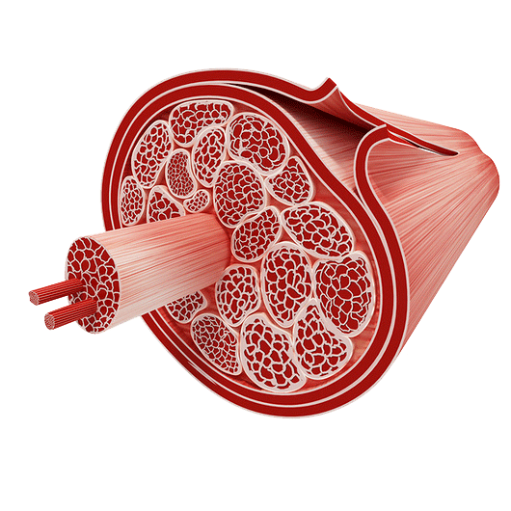
Metformin: mechanism of action
Metformin¹
Intestine
Liver
Skeletal muscle
↑ Glucose utilisation
↓ Gluconeogenesis
↓ Glycogenolysis
↓ Fatty acid oxidation
↑ Insulin-mediated glucose uptake
↑ Glycogenesis
↓ Fatty acid oxidation
↓ Hyperglycaemia
Notes:
Notes
Metformin is a first-line glucose-lowering agent and is most widely used to treat T2D
Metformin decreases hyperglycaemia primarily by suppressing glucose production (inhibition of gluconeogenesis) by the liver
In addition to its glucose-lowering effect, metformin has been found to provide various benefits, e.g. improving plasma lipid profile, as shown in large clinical trials¹
The effects of metformin on CV risk factors require further assessment, but may include improved lipid profiles, anti-atherogenic effects, decreased ischaemic injury and amelioration of oxidative stress¹
Recent research at the gut level reveals new pharmacological actions of metformin including alteration of bile acid recirculation and gut microbiota resulting in enhanced enteroendocrine hormone secretion (particularly GLP-1)²
Abbreviations
CV, cardiovascular; GLP-1, glucagon-like peptide-1; T2D, type 2 diabetes
Reference
1. Batchuluun et al. J Endocrinol Diabetes Obes 2014;2:1035
2. Napolitano A et al. PLoS One 2014; 9(7): e100778
Copyright
Bailey CJ & Feher MD. Therapies for Diabetes 2004. Figure 6.5

Slide 25
Metformin pros and cons
Pros | Cons
HbA1c reduction: 1-1.5% | GI disturbances
Body weight stable or decreased | Caution in patients with risk factors for lactic acidosis or drug accumulation, condition associated with hypoxia
Low risk of hypoglycaemia
Potential CV benefits
Metformin first line for T2D patients

Slide 26
Sulphonylureas: mechanism of action
Notes:
Notes
SUs are a common second-line therapy for T2D (after metformin)
SUs lower glucose by stimulating insulin secretion from the pancreas
Normally, the metabolism of an influx of glucose causes the ATP/ADP ratio to rise, leading to closure of the K_{ATP} channel, depolarisation of the β-cell membrane, influx of calcium ions and, finally, the release of insulin from storage granules
SUs bind to a specific receptor on the K_{ATP} channel, causing it to close and triggering the same series of events, and also causing impaired ischaemic pre-conditioning in cardiac myocytes
Abbreviations
ADP, adenosine diphosphate; ATP, adenosine triphosphate; K_{ATP}, adenosine triphosphate-dependent potassium channel; SU, sulphonylurea; T2D, type 2 diabetes
Reference
The figure was produced using Servier Medical Art: http://www.servier.com/Smart/ImageBank.aspx?id=729.
Copyright
Gore MO and McGuire DK. Eur Heart J 2011;32:1832. Figure 1

Slide 27
SUs: pros and cons
Pros | Cons
HbA1c reduction: 1.3% | Risk of hypoglycaemic events
Can be used as an add-on | 2-5 kg weight gain
 | Contraindicated in patients with moderate to severe liver dysfunction
CV outcome concerns:
UGDP: safety concerns with tolbutamide (excess of cardiac deaths vs placebo)
ADVANCE: intensive glucose-lowering including gliclazide was not associated with negative CV outcomes vs standard treatment

Slide 28
Thiazolidinediones (TZD; PPAR-γ agonists): mechanism of action
TZD
Skeletal muscle
Adipose
Liver
↑ Glucose uptake
PPARγ activation
↓ Gluconeogenesis
Adipogenesis
↑ Fatty acid uptake
↑ Lipogenesis
↑ Glucose uptake
↓ Plasma FFA
↓ Hyperglycaemia
Notes:
Notes
PPAR activation regulates the expression of multiple target genes involved in glucose homeostasis, fatty acid oxidation and lipid metabolism
In addition to improving glucose control and insulin sensitivity, TZDs reduce concentrations of atherogenic lipoproteins and decrease inflammatory mediators
Abbreviations
PPAR, peroxisome proliferator-activated receptor; TZD, thiazolidinedione
Copyright
Adapted from Bailey CJ & Feher MD. Therapies for diabetes including oral agents and insulins. Sherborne Gibbs Limited, 2004. Figure 7.5

Slide 29
TZDs: Pros and cons
Pros | Cons
HbA1c reduction: 1.4% | Weight gain
Low risk of hypoglycaemia when used as monotherapy | Oedema, anaemia, pulmonary oedema, and congestive heart failure
 | Anaemia
 | Potential CV risk

Slide 30
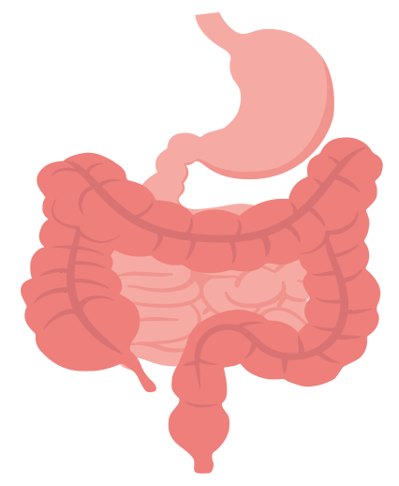
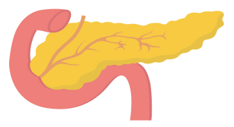
Mechanism of action of DPP-4 inhibitors
Meal ingested
Stimulates glucose-dependent
insulin secretion
DPP-4 inhibitor
Inactive GLP-1
Suppresses postprandial
glucagon secretion
Stomach
DPP-4
Active GLP-1
Slows gastric emptying
Pancreas
Large
intestine
β-cells

Slide 31
DPP4 inhibitors: Pros and cons
Pros | Cons
HbA1c reduction: 0.5-1.1% | Increased hospitalisation for heart failure (saxagliptin)
Low risk of hypoglycaemia when used as monotherapy | Small risk for pancreatitis
Weight neutral
Can be used as monotherapy or add-on
CV neutral

Slide 32
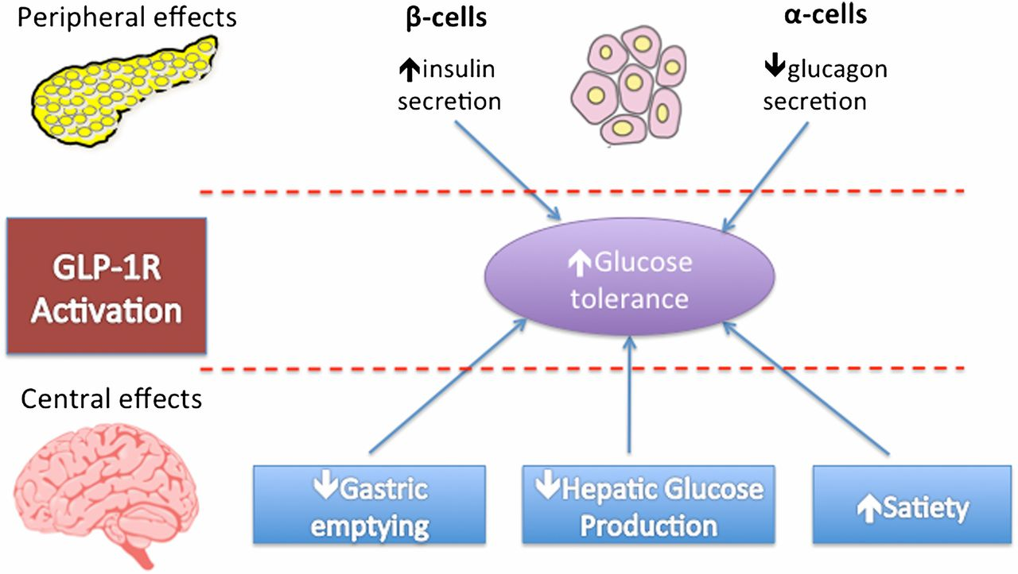
GLP-1R mechanism of action

Slide 33
GLP-1R agonists: Pros and cons
Pros | Cons
HbA1c reduction: 0.9-1.2% | Nausea and vomiting (discontinuation ≈ 25%)
Low risk of hypoglycaemia when used as monotherapy | Pancreatitis
Weight reduction: 1-3 kg | Skin reactions
Add-on therapy | Injectable
SBP reduction: 1-5 mmHg
CV benefits for some molecules

Slide 34
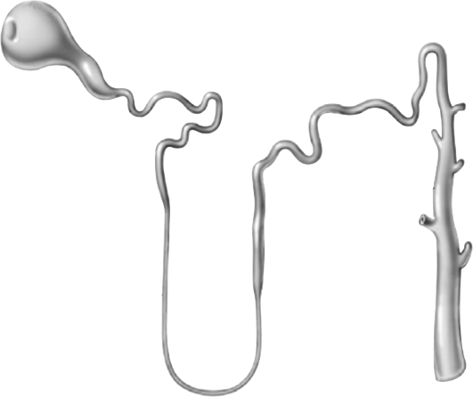
Urinary glucose excretion via SGLT2 inhibition
Filtered glucose load >180 g/day
SGLT2 inhibitors reduce glucose reabsorption in the proximal tubule, leading to urinary glucose excretion* and osmotic diuresis
SGLT2
SGLT2 inhibitor
SGLT1
SGLT2 inhibitors are insulin independent

Slide 35
SGLT2 inhibitors: Pros and cons
Pros | Cons
HbA1c reduction: 0.6-1.2% | Increase in genital infections
Weight reduction: 1.6-2.5 kg | Potential increase in UTIs
SBP reduction: 1-5 mmHg | Lower limb fractures and amputations (canagliflozin)
Monotherapy and add-on
Low risk of hypoglycaemia when used as monotherapy
Varying CV benefits

Slide 36
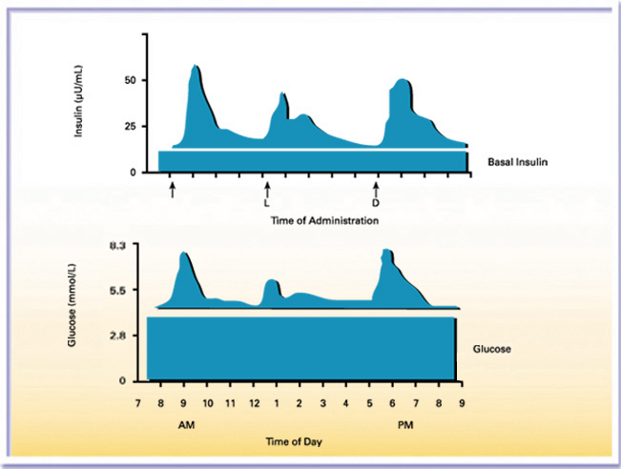
Physiologic Insulin Secretion:
24-hour Profile
Source: Advances in Insulin Therapy: The New Paradigm in Diabetes Care – Martin J Abrahamson (www.Medscape.com CME Activity 27 Sept 2001)

Slide 37
What challenges do patients face?
“I’ve always struggled with my weight. Now my doctor says I need more insulin because my HbA_{1c} is high, so I’m worried about gaining more weight”
“ I’ve had hypos, they have been really scary. Now, my HbA_{1c} is high so my insulin is being increased – I’m scared of having more hypos”
“After trying many medications, my HbA_{1c} is still high. My doctor says I need basal-bolus therapy, but I already find it difficult to manage my regimen and don’t want even more injections”

Slide 38
Potential barriers to optimal treatment
HCPs
Examples of barriers:
Complex regimens
Fear of needles or injections
Hypoglycaemia
Weight gain
Poor efficacy
A feeling of failure
Cost
Forgetfulness
Insufficient use of clinical guidelines
Lack of diabetes knowledge
Poor health literacy
Different perspectives
H
Health system
Patient
1. Carls G et al. Diabetes Ther. 2017;8: pg 871; 2. Farr et al. Adv Ther. 2014 Dec;31(12):1287-305; 3. García-Pérez LE et al. Diabetes Ther. 2013;4: pg 180, 182, 185; 4. Nakar S, et al. J Diabetes Complications. 2007; 21:220-226; 5. Petznick AM, et al. J Am Osteopath Assoc. 2013;113 (Suppl 2):S6-S16; 6. Polonsky WH et al. Diab Care. 2005;28:2543-2545; 7. Ross SA. Am J Med. 2013;126:S39.
Notes:
García-Pérez LE et al. Diabetes Ther. 2013;4: pg 180, 182, 185.
Core science deck:
Slide 17
Carls G et al. Diabetes Ther. 2017;8: pg 871.
Ross SA. Am J Med. 2013;126: S39.
Farr et al. Adv Ther. 2014 Dec;31(12):1287-305
Nakar S, et al. J Diabetes Complications. 2007; 21:220-226
Petznick AM, et al. J Am Osteopath Assoc. 2013;113 (Suppl 2):S6-S16
Polonsky WH et al. Diab Care. 2005;28:2543-2545

Slide 39
Case # 1

Slide 40
Case #1: Pieter, 57-year-old male with T2D
Pieter / M / 57 yrs
57-year old male
Works as a policeman
Diagnosed with T2D 16 years ago
BMI: 30 kg/m²
Current treatment:
Metformin 1000 mg BID
42 U IGlar at bedtime + 8 U of IAsp three times a day
Most recent HbA_{1c}: 8.1%

Slide 41
Case #1: Pieter, 57 year-old male with T2D
Pieter / M / 57 yrs
Pieter checks his blood sugar, but not as often as he should
His most recent FPG reading was 7.9 mmol/L (142 mg/dl) and his PPG after breakfast has been on average 14.5 mmol/L (261 mg/dl)

Slide 42
Consequences of non-adherence in diabetes
Non-adherence in diabetes is associated with significantly higher rates of hospitalisation and mortality than adherence
All-cause hospitalisation
All-cause mortality
p<0.001
p<0.001
25
7
20
6
5
15
Rate (%)
Rate (%)
4
10
3
5
2
1
0
Adherent
Non-adherent
0
Adherent
Non-adherent
Miccoli et al. Diabetes Care 2011;34(Suppl. 2):S231–5
Notes:
Miccoli R, Penno G, Del Prato S. Multidrug Treatment of Type 2 Diabetes A challenge for compliance. Diabetes Care. 2011;34(Supplement 2):S231-S235.

Slide 43
Case #1: Pieter, 57-year-old male with T2D
Pieter / M / 57 yrs
Pieter tells you that he sometimes forgets to take his mealtime insulins
At work, it’s not always easy for him to take his insulin with lunch
He admits that he also feels uncomfortable taking his injections around his co-workers

Slide 44
Case #1: Pieter, 57-year-old male with T2D
Pieter / M / 57 yrs
Pieter has to work overnight shifts on a regular basis
When this happens, he is often confused about adjusting the timing of injections and/or if he should adjust his doses
As a result, he admits that he will sometimes just skip taking some of his injections

Slide 45
Simplification of medication dosing improves adherence
Adherence is inversely proportional to frequency of dose
100
90
80
70
60
Rate of adherence (%)
50
40
30
20
10
0
OD
BID
TID
QID
Medication schedule
BID, twice daily; OD, once daily; QID, four-times daily; TID, three-times daily Claxton et al. Clin Ther 2001;23:1296–310
Notes:
Osterberg, L., & Blaschke, T. Adherence to medication. New England Journal of Medicine 2005:353(5);487-497.
Claxton, AJ, Cramer J, Pierce, C. A systematic review of the associations between dose regimens and medication compliance. Clinical therapeutics 2001:23(8);1296-1310.
Notes on study: data are taken from a systematic review in which medication compliance was measured by EM devices to determine the associations between dosing frequency and and compliance (Claxton et al) – general adherence, not diabetes-specific.

Slide 46
Simplicity of using IDegAsp
Low number of injections
Low insulin dose
Less glucose monitoring
Easy regimen of insulin intensification in T2D
1. Kalra S, Latif ZA, Comlekci A, et al. Indian J Endocr Metab. 2016;20:542-545; 2. Ryzodeg® (IDegAsp) [European Public Assessment Report (EPAR)—Product Information]. Bagsværd, Denmark: Novo Nordisk A/S; Nov 2017.

Slide 47
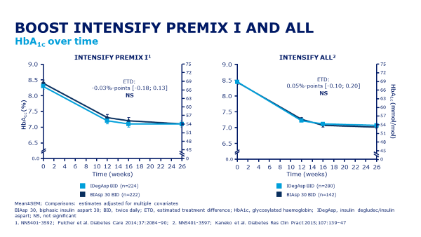
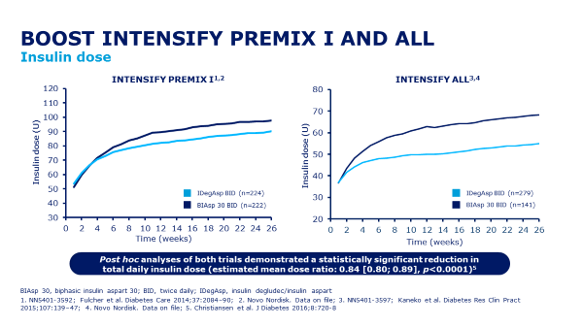
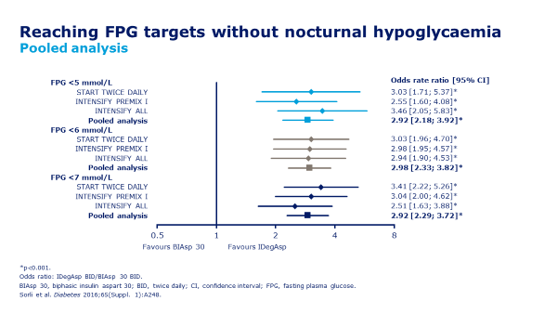
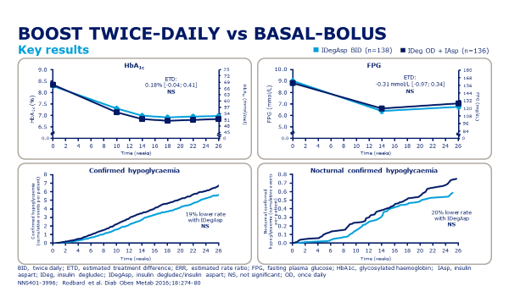
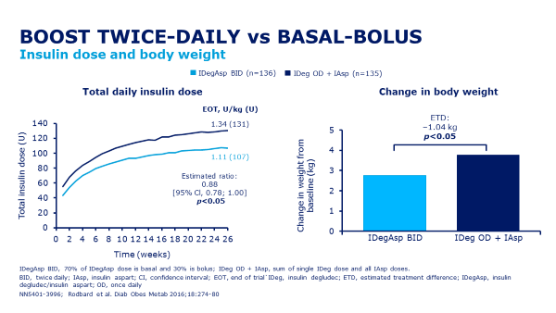
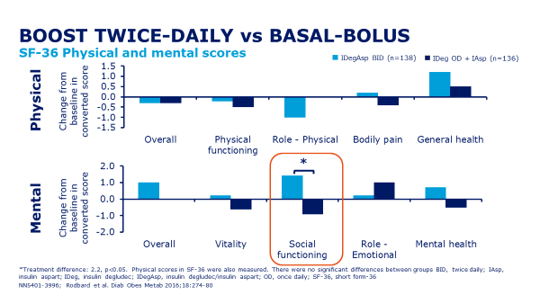
IDegAsp clinical programme data show:
Similar HbA_{1c} control, lower FPG and lower nocturnal hypoglycaemia rate, with lower insulin dose for IDegAsp BID vs. premix BID
Similar glycaemic control and hypoglycaemia rate with lower insulin dose, smaller weight increase, and improvement in social functioning for IDegAsp BID vs. basal-bolus

Slide 48
Study Efficacy summary
Treatment initiation (week 0–26) IDegAsp OD/BID vs IGlar U100 + IAsp OD-TID
Full trial period (week 0–38), IDegAsp OD/BID vs IGlar U100 + IAsp OD-TID
IDegAsp
Non-inferiority confirmed
HbA_{1c} reduction | Non-inferiority confirmed in change from baseline ETD: 0.07%, 95% CI: [-0.06; 0.21] Consistent across sensitivity analysis | No difference
FPG control | No difference | No difference
PPG increments | No difference | No difference
Pre-breakfast SMPG | Significantly higher with IDegAsp ETD: 0.28 mmol/L, 95% CI: [0.05; 0.51] | No difference
IGlar U100 + IAsp
1.62
Injections
(83.4 U)
HbA_{1c} over time (%)
2.85
Injections
(89.3 U)
0.0
Time (weeks)
BID, twice-daily; CI, confidence interval; ETD, estimated treatment difference; FPG, fasting plasma glucose; IAsp, insulin aspart; IDegAsp, insulin degludec/insulin aspart; IGlar U100, insulin glargine U100; OD, once-daily; SMPG, self-measured plasma glucose; TID, thrice-daily. 1. Novo Nordisk. NN5401-4266. Data on file.

Slide 49
Less complex dosing of IDegAsp BID vs. basal–bolus¹⁻¹⁰
Basal + Bolus
IDegAsp BID
Mon
Tue
Wed
Thu
Fri
Sat
Sun
Mon
Tue
Wed
Thu
Fri
Sat
Sun
Breakfast
1st Main Meal
Lunch
Dinner
Mon - Sun
2nd Main Meal
BASAL*
28 SMBGs/week 28 needles/week
6 SMBGs/week 14 needles/week
Bolus
Basal
SMBG test strip
IDegAsp
*Once-daily SMBG testing is recommended with current basal insulin analogues.¹⁻³ Insulin degludec may be used with a simple monitoring and titration algorithm in patients with T2D: Once-weekly titration based on the average of 2 preceding FPG measurements ^{4,5}. BID, twice daily; FPG, fasting plasma glucose; IDegAsp, insulin degludec/insulin aspart; SMBG, self-measured blood glucose; T2D, type 2 diabetes. 1. Starting patients on Levemir®. http://www.levemirpro.com/prescribing/dosing.aspx; 2. Davies et al. Diabetes Care 2005;28:1282–8; 3. Titration guide for Lantus® http://www.lantus.com/hcp/dosing-titration/titration-guide.aspx; 4. Endocrinologic and Metabolic Drug Advisory Committee. Insulin degludec and insulin degludec/insulin aspart treatment to improve glycemic control in patients with diabetes mellitus: NDAs 203314 and 203313 briefing document. http://www.fda.gov/downloads/AdvisoryCommittees/CommitteesMeetingMaterials/Drugs/EndocrinologicandMetabolicDrugsAdvisoryCommittee/UCM327017.pdf; 5. Rodbard et al. Diabet Med 2013;30:1298–304; 6. NICE. Guidance on the use of long-acting insulin analogues for the treatment of diabetes – insulin glargine. Technology App no 53. Dec 2002; 7. ADA. Diabetes Care. 2014;37(Suppl. 1):S14-S80; 8. Fulcher et al. Diabetes Care 2014;37:2084-90; 9. Kaneko et al. Diabetes Res Clin Pract 2015;107:139-47; 10. FDA Briefing Document. NDA 203313 and NDA 203314 Insulin degludec and insulin degludec/aspart. http://www.fda.gov/downloads/AdvisoryCommittees/CommitteesMeetingMaterials/Drugs/EndocrinologicandMetabolicDrugsAdvisoryCommittee/UCM327015.pdf
Notes:
Dosed twice-daily IDegAsp offers less complex dosing for patients with T2D compared with basal–bolus based on the number of daily and weekly injections

Slide 50
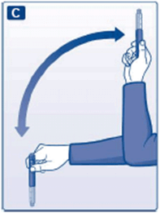
Less complex dosing of IDegAsp BID vs. premix BID
Mealtime flexibility
Resuspension not needed
IDegAsp: no shoulder effect
BID dosing with the 2 main meals
BiAsp re-suspension instructions:
Always make sure that you have resuspended the insulin prior to each injection. This reduces the risk of too high or too low blood sugar level
Always check there are at least 12 units of insulin in the cartridge
Move the pen up and down at least 10 times
Do not use if the resuspended insulin does not look uniformly white, cloudy and aqueous
BiAsp: shoulder effect
BID dosing with pre-breakfast & pre-main evening meal

Slide 51
Challenges of maintaining glycaemic control Surveys identifying challenges with rigid regimens and the fear of hypoglycaemia
Complex and inflexible regimens¹
Fear of hypoglycaemia²
All comparisons significant
Proportion of patients (%)
Increasing severity of hypoglycaemia
HFS, Hypoglycaemia Fear Survey; 2. Total patient sample, n=1984
1. Peyrot et al. Diabet Med 2012;29:682–9; 2. Marrett et al. Diabetes 2008;57(Suppl. 1):A174
Notes:
Hypoglycaemia, the fear of hypoglycaemia and the complex and inflexible nature of insulin regimens are significant barriers to achieving glycaemic control with insulin.
Abstracts:
Peyrot et al. Diabetic Med 2012;29:682–9
Aims: To examine patient and physician beliefs regarding insulin therapy and the degree to which patients adhere to their insulin regimens.
Methods: Internet survey of 1250 physicians (600 specialists, 650 primary care physicians) who treat patients with diabetes and telephone survey of 1530 insulin-treated patients (180 with Type 1 diabetes, 1350 with Type 2 diabetes) in China, France, Japan, Germany, Spain, Turkey, the UK or the USA.
Results: One third (33.2%) of patients reported insulin omission/non-adherence at least 1 day in the last month, with an average of 3.3 days. Three quarters (72.5%) of physicians report that their typical patient does not take their insulin as prescribed, with a mean of 4.3 days per month of basal insulin omission/non-adherence and 5.7 days per month of prandial insulin omission/non-adherence. Patients and providers indicated the same five most common reasons for insulin omission/non-adherence: too busy; travelling; skipped meals; stress/emotional problems; public embarrassment. Physicians reported low patient success at initiating insulin in a timely fashion and adjusting insulin doses. Most physicians report that many insulin-treated patients do not have adequate glucose control (87.6%) and that they would treat more aggressively if not for concern about hypoglycaemia (75.5%). Although a majority of patients (and physicians) regard insulin treatment as restrictive, more patients see insulin treatment as having positive than negative impacts on their lives.
Conclusions: Glucose control is inadequate among insulin-treated patients, in part attributable to insulin omission/non-adherence and lack of dose adjustment. There is a need for insulin regimens that are less restrictive and burdensome with lower risk of hypoglycaemia.
Peyrot et al. Diabetes Care
Objective: The purpose of this study was to assess factors associated with patient frequency of intentionally skipping insulin injections.
Methods: Data were obtained through an Internet survey of 502 U.S. adults self-identified as taking insulin by injection to treat type 1 or type 2 diabetes. Multiple regression analysis assessed independent associations of various demographic, disease, and injection-specific factors with insulin omission.
Results: Intentional insulin omission was reported by more than half of respondents; regular omission was reported by 20%. Significant independent risk factors for insulin omission were younger age, lower income and higher education, type 2 diabetes, not following a healthy diet, taking more daily injections, interference of injections with daily activities, and injection pain and embarrassment. Risk factors differed between type 1 and type 2 diabetic patients, with diet nonadherence more prominent in type 1 diabetes and age, education, income, pain, and embarrassment more prominent in type 2 diabetes.
Conclusions: Whereas most patients did not report regular intentional omission of insulin injections, a substantial number did. Our findings suggest that it is important to identify patients who intentionally omit insulin and be aware of the potential risk factors identified here. For patients who report injection-related problems (interference with daily activities, injection pain, and embarrassment), providers should consider recommending strategies and tools for addressing these problems to increase adherence to prescribed insulin regimens. This could improve clinical outcomes.

Slide 52
Ultra long acting insulin and GLP-1RA combination benefits
R
Reduced injection burden:
Fewer injections vs basal bolus
Cost effective:
↓ medication costs
↓ Hypo events costs
Once daily dosing:
2 medications in 1 device
Improved compliance and adherence
Established with extensive clinical trial evidence

Slide 53
Treatment
Natural products : DM
Natural products : Metabolic
Chromium polynicotinate
Guar gum
HCA
Bitter Melon
Cinnamon
D-Chiro inositol
Berberine
Alpha lipoic acid
Gymneva sylvestra
Vit B’s and Magnesium
Cholesterol Balance
Liver Balance
Weight loss products
Vit D3

Slide 54
Contact us on:
010 109 6177 or 011 440 8721
Or pa@drsbhana.co.za

